Slide 1



Bi-Weekly Update 1
Team 32: Abhi Singh, Holden Haile, Kelton Chesshire Sponsor: Skyelar Head TA: Eric Lloyd Robles
Notes:
Michelle

Slide 2
Problem Statement
In the U.S. Alone over 10% of the population suffers from Diabetes. Type 1 diabetes can require a person to monitor their blood sugar level 4-10 times a day and intake carbohydrates if their blood sugar is low. This can become a guess and check game where the person is not able to consistently and accurately dose themselves, and can lead to detrimental effects on quality of life.

Slide 3
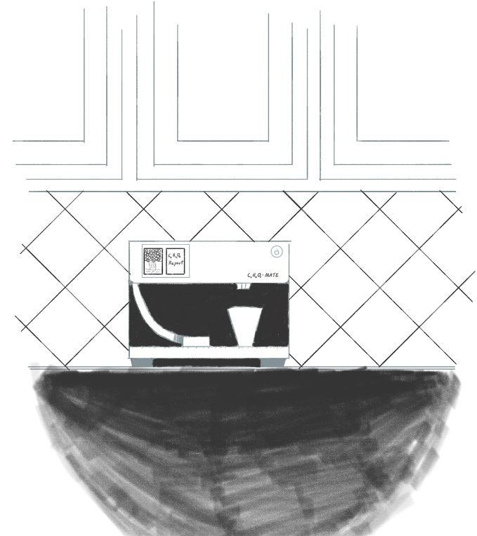
Solution Proposal
Our system will dispense carbohydrates in a consistent, accurate, and easily-consumable manner so that users have an easy way of maintaining a normal blood sugar level 24/7.

Slide 4
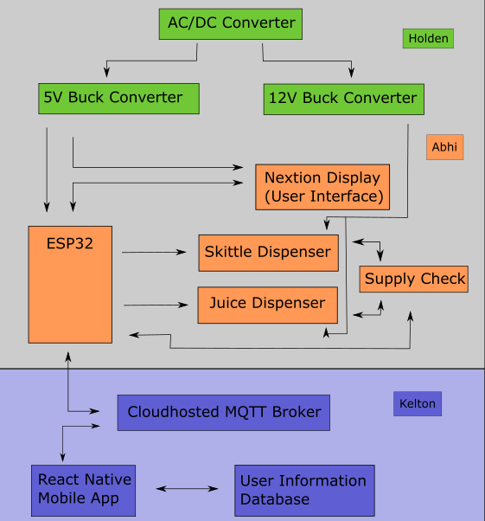
System Overview
Power Supply
Dispenser
Application

Slide 5
Subsystem Changes/Improvements for 404
Design Changes proposed to us by Dr. John Lusher and Subsystem Improvements that are being added for 404
Dispenser: Implementing the Skittle & Juice Stock Checker for our Dispenser, improving switching design of the dispenser, implement Nextion display
Power Supply: Swapping Voltage Regulators out and Downsizing Capacitors on Power Supply
Application: Status notifications, Glucose input, integration with Apple HealthKit and Google Fit
Notes:
Eric

Slide 6
Project Timeline
Last Week
Next 2 weeks
10/5
11/5
11/16
Discuss System Improvements
Subsystem Improvements
Major Project Design
Final Subsystem Integration
Preparation for Final Presentation & Demo
We focused on how to improve our subsystems from the good baseline from 403
Subsystem Improvements will be made and tested
Design Housing and PCBs for Power Supply and Dispenser, App integration with Health Apps, HMI control implemented
Dispenser and Power Supply will be installed in the housing, testing and validation of System: Dispenser powered with our Power Supply and Tested with Our App
Final Tweaks to subsystems if needed, polishing the product for presentation and testing user experience
Notes:
Eric

Slide 7
Power Supply
Holden Haile
Accomplishments since 403 15 hrs of effort | Ongoing progress/problems and plans until the next presentation
Buck converters integrated with the MCU Discussed issues with Dr. Lusher | Implementation of re-design suggestions from Dr. Lusher Begin PCB design Begin housing design

Slide 8
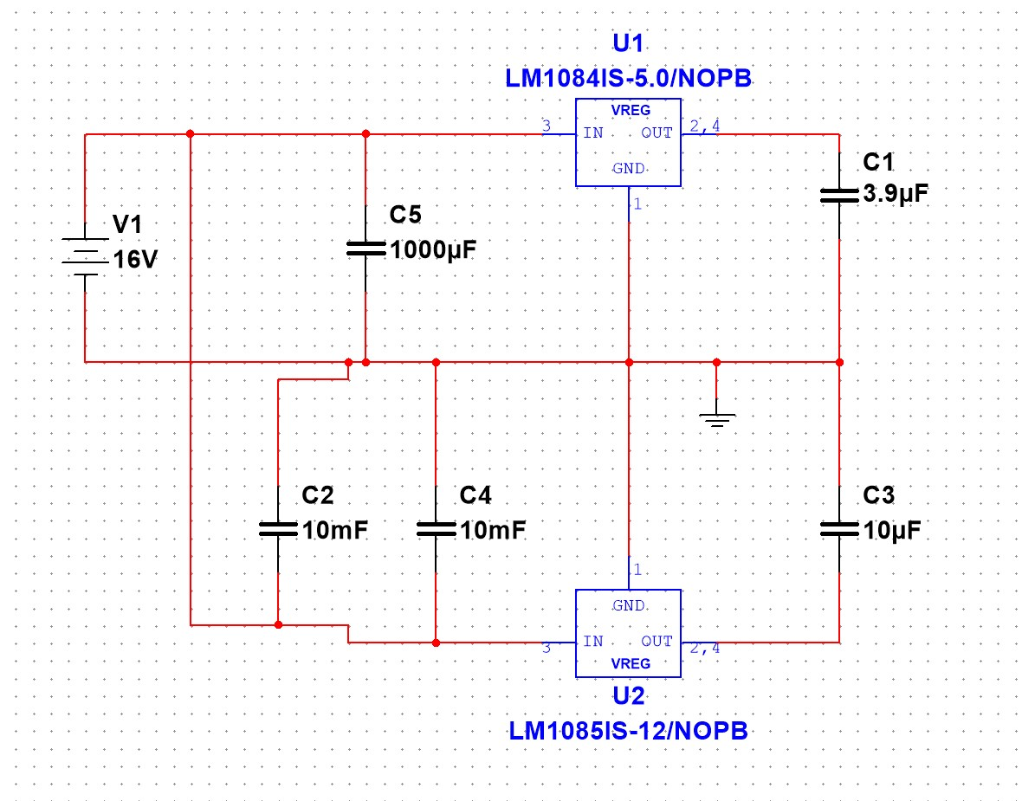
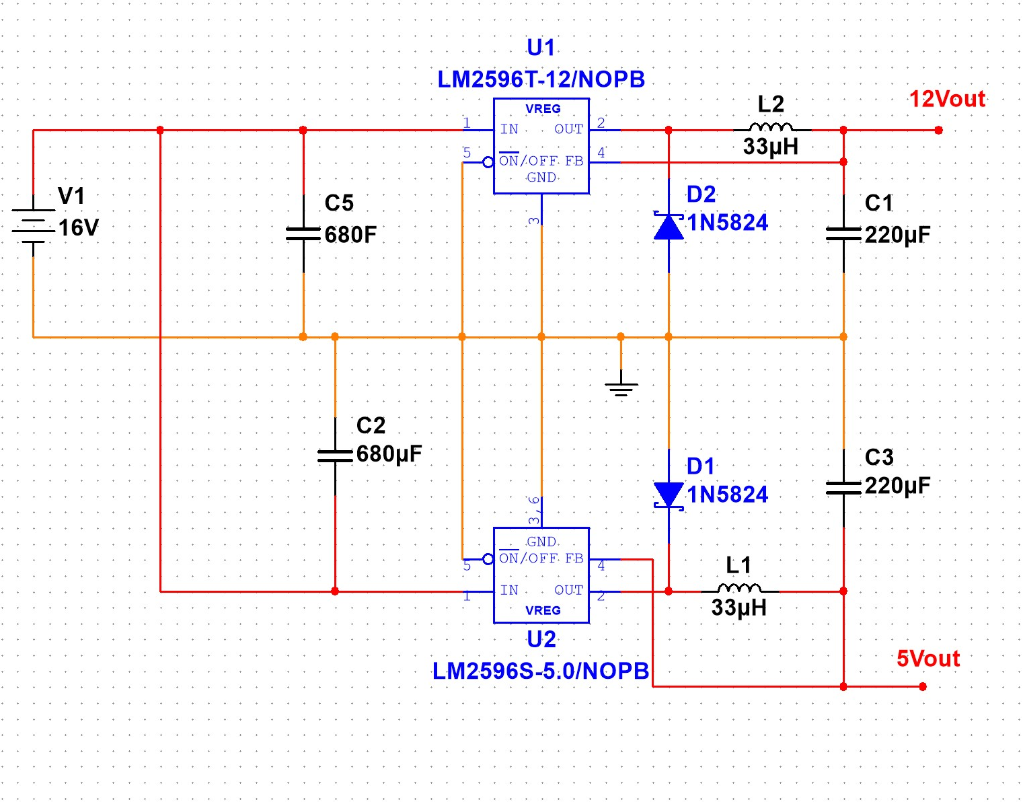
Power Supply
Holden Haile
5V buck - working
12V buck - not providing enough power to operate at the speeds that we would like
Revised buck design below

Slide 9
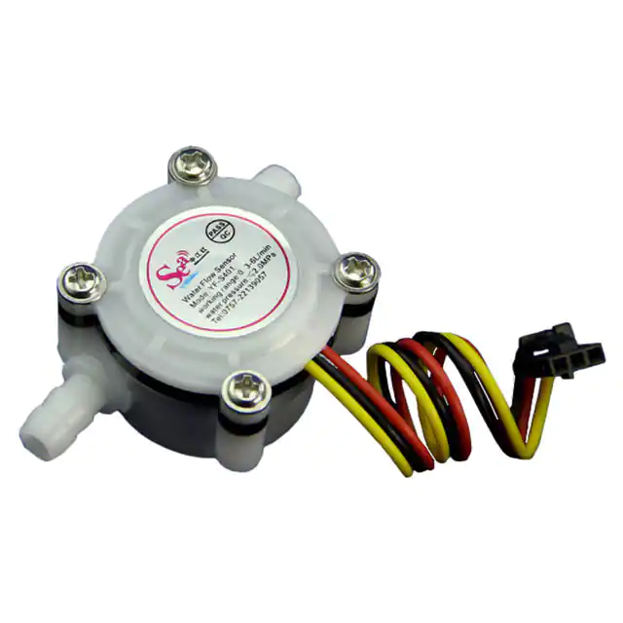
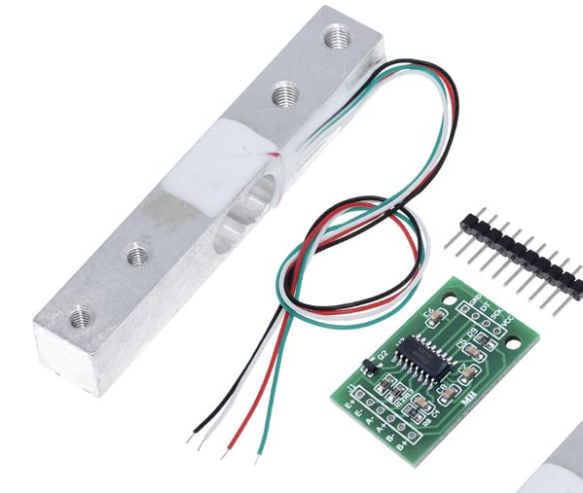
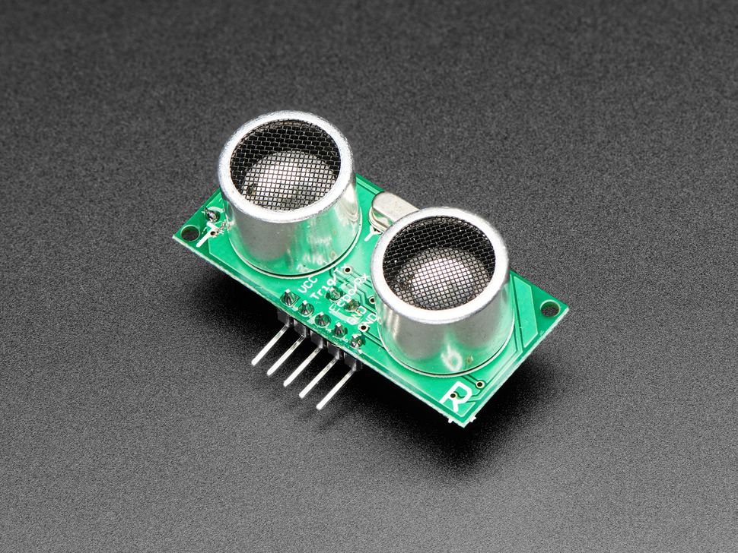
Dispenser
Abhi Singh
Accomplishments since 403 5 hrs of effort | Ongoing progress/problems and plans until the next presentation
Research and Sourced Sensors for Stock Checker Designed improved circuitry for dispenser using CMOS transistors instead of HV Relays | Test Ultrasonic and Pressure sensors with ESP32 Test MOSFET circuit on breadboard Implement Nextion Display (HMI)

Slide 10
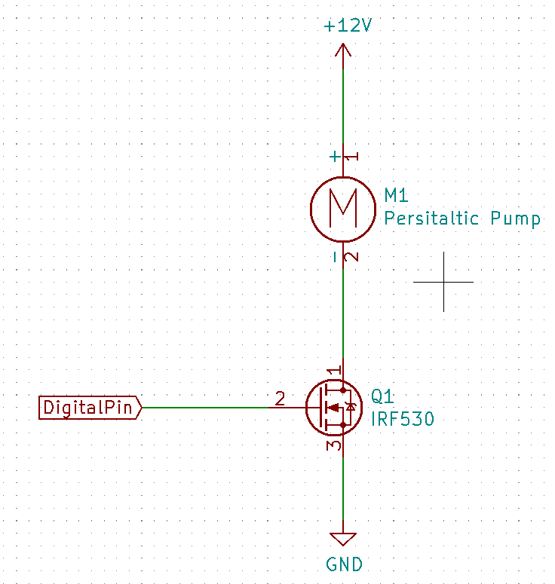
Dispenser
Abhi Singh
N Channel MOSFET on the low side of the load (pump & solenoid)
Components are here, just have to test the circuit for proof of concept
Better alternative to what we used last semester (HV relay Optocoupler)

Slide 11
Application
Kelton Chesshire
Accomplishments since 403 12 hrs of effort | Ongoing progress/problems and plans until the next presentation
MQTT Communication w/ Dispenser Google Firestore Database Firebase Authentication Basic Dispense Function Previous Dispensings Screen | Dispenser Notifications Glucose Input BMI Information Work on Nextion Display with Abhi

Slide 12
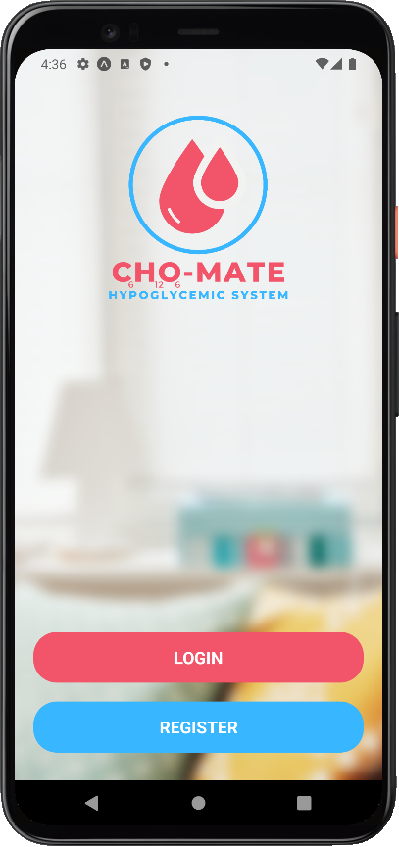
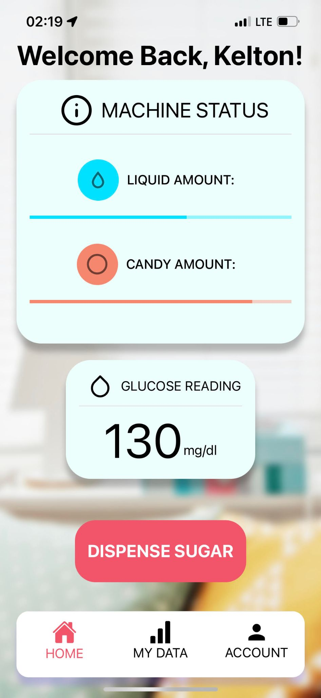
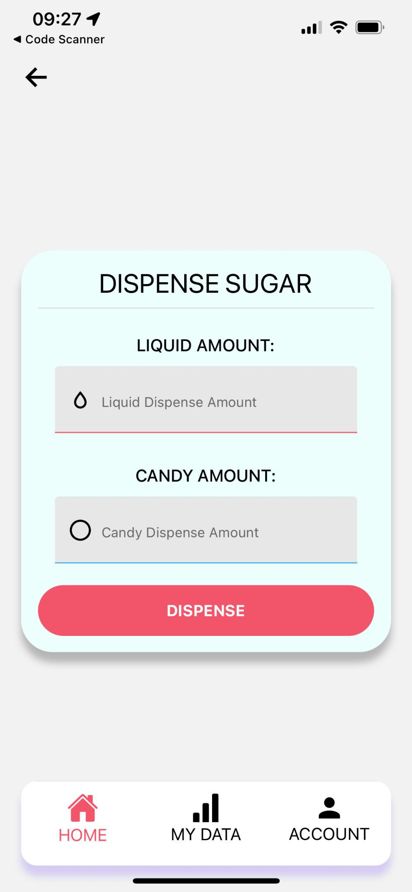
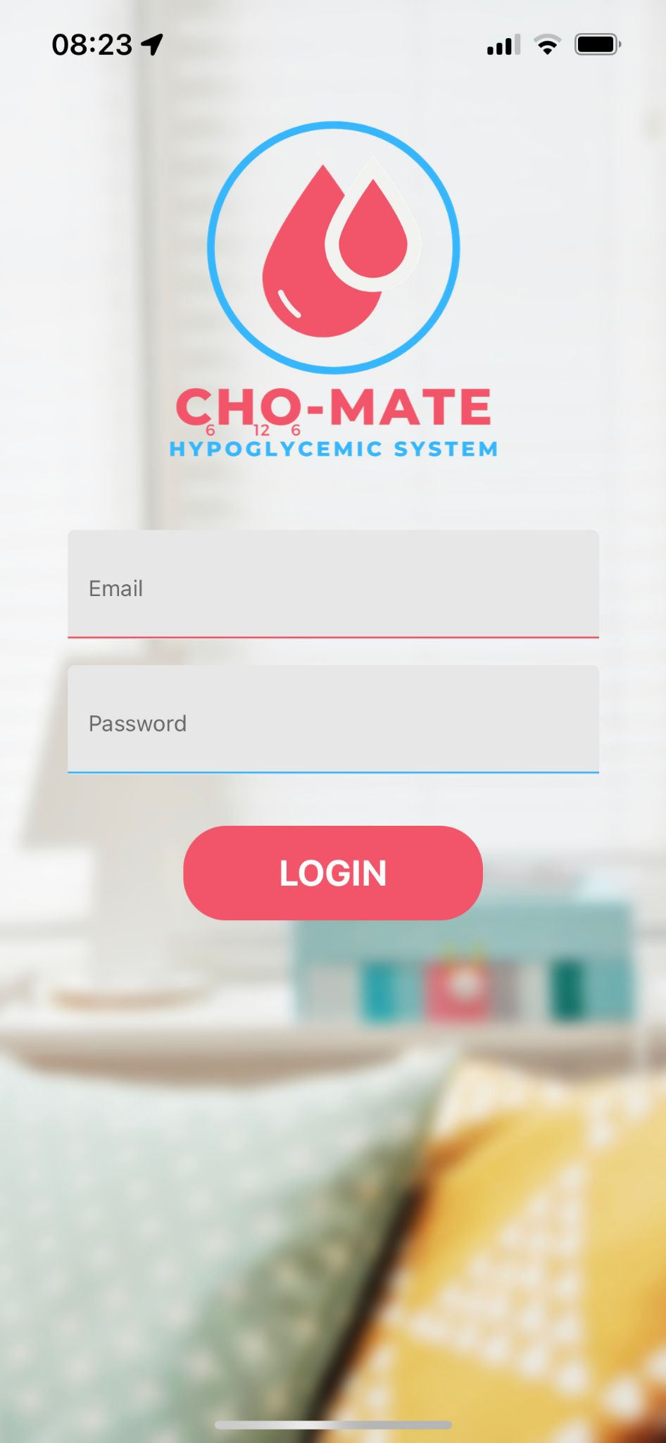
Application
Kelton Chesshire

Slide 13
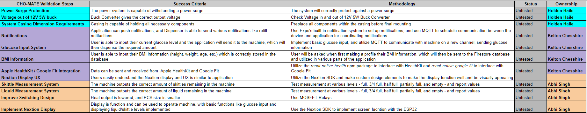
Validation Plan
Notes:
Michelle

Slide 14
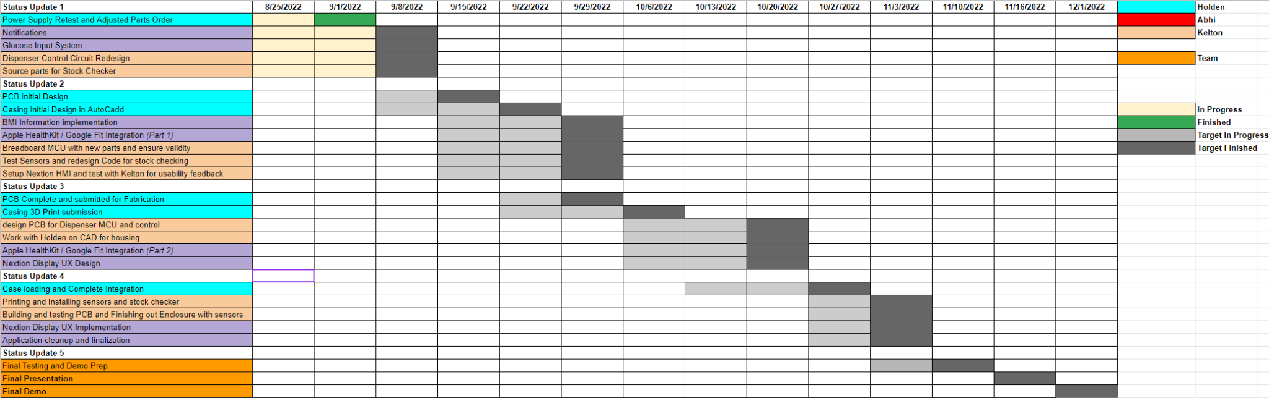
Execution Plan

Slide 15
Questions?

